Slide 1
Machine Learning Pipeline

Slide 2
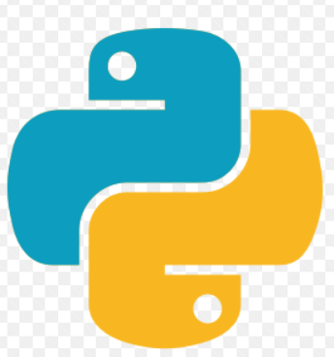


Data Ingestion
Data Processing and Feature Engineering
Training
Deployment
Prediction
Cleaning, dealing with missing values, Normalize, Analysis of biases, available features, getting new features based on domain or data analysis.
Configure Models, Selection of model
Output : Trained models
Backend
Client side
Online/
Offline predictions
ETL / Data Stores
Note:
dask and joblib are most common frameworks used for parallelization.
https://docs.dask.org/en/latest/
https://joblib.readthedocs.io/en/latest/
Airflow is used for scheduling jobs.
https://airflow.apache.org/docs/
DVC is used for data versioning.
https://dvc.org/doc

Slide 3
References https://www.infoworld.com/article/3198252/data-in-intelligence-out-machine-learning-pipelines-demystified.html https://developers.google.com/machine-learning/testing-debugging/pipeline/overview https://www.xplenty.com/blog/comparison-of-the-top-python-etl-tools

